Slide 1
C++ Programming: From Problem Analysis to Program Design (D.S. Malik, 2018) A First Book of C++, (G. Bronson, 2012) C++ for Everyone (C.S. Horstman, 2012)
CHAPTER 9 (Pt 1)
Single Structures, Array names & Structure as function arguments
ELEMENTS OF PROGRAMMING
CSC 1100

Slide 2
Objectives
CSC 1100 – Week11
DCS, KICT
In this chapter, you will learn about:
Single Structures
Arrays of Structures
Structures as Function Arguments

Slide 3
Single Structures
CSC 1100 – Week11
DCS, KICT
Structure: data structure that stores different types of data under single name
A structure is a class that has no methods
All variables of class are public (default)
Creating and using a structure requires two steps:
Declaration
Assigning values
A First Book of C++ 4th Edition

Slide 4
Single Structures (cont'd.)
CSC 1100 – Week11
DCS, KICT
Structure declaration (local declaration): list the data types, data names, and arrangements of data items
Example: birth structure consists of three data items or fields called structure members
struct
{
int month;
int day;
int year;
} birth;
name of structure
1st member
2nd member
3rd member
A First Book of C++ 4th Edition

Slide 5
Single Structures (cont'd.)
CSC 1100 – Week11
DCS, KICT
Populating the structure: assigning data values to data items of a structure
Data structure members are accessed by giving the structure name and individual data item name separated by the dot (‘.’)
Dot is called member access operator (dot operator)
Example: birth.month refers to the first member of birth structure
Program 16.1 assigns values to individual members of birth structure
A First Book of C++ 4th Edition

Slide 6
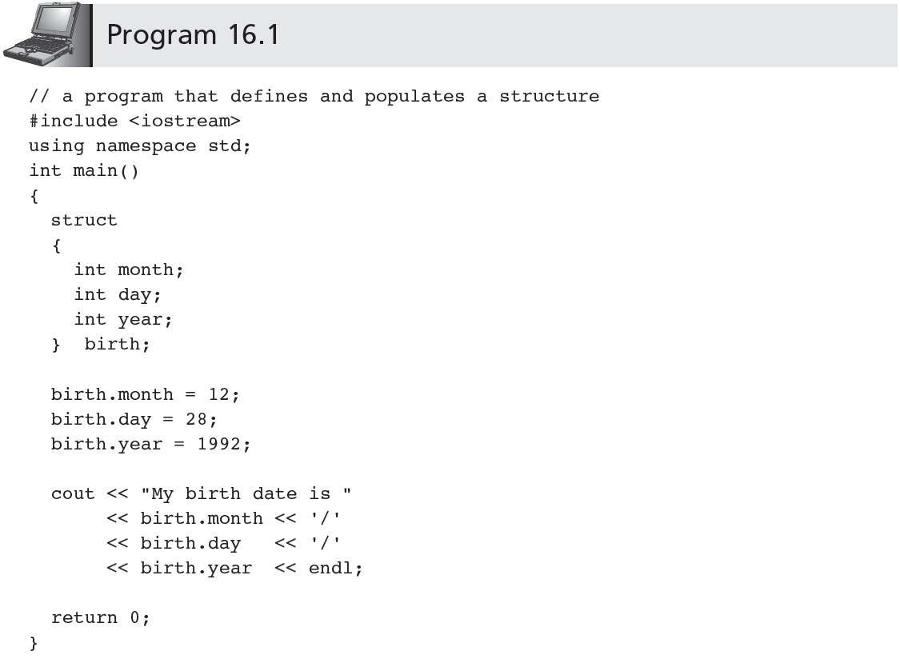
CSC 1100 – Week11
DCS, KICT
'local' structure declaration
(declaring members of structure)
assign values to structure members (using the “.” operator)
display values from structure members
A First Book of C++ 4th Edition

Slide 7
Single Structures (cont'd.)
CSC 1100 – Week11
DCS, KICT
Output produced by program 16.1:
My Birth date is 12/28/1992
Format of structure definition is flexible: the following is valid :
struct {int month; int day; int year;} birth;
Multiple variables can be declared in the same statement
struct {int month; int day; int year;} birth, current;
Creates two structures of the same form
birth.day, birth.month, birth.year
current.day, current.month, current.year
A First Book of C++ 4th Edition

Slide 8
Single Structures (cont'd.)
CSC 1100 – Week11
DCS, KICT
Modified format for defining structures (global scope)
struct Date
{
int month;
int day;
int year;
};
Date: structure type name
Definition statement:
Date birth, current;
Reserves storage for two date structure variables named birth and current
Example: Program 16.2 illustrates declaration of a Date data type
name of global structure
A First Book of C++ 4th Edition

Slide 9
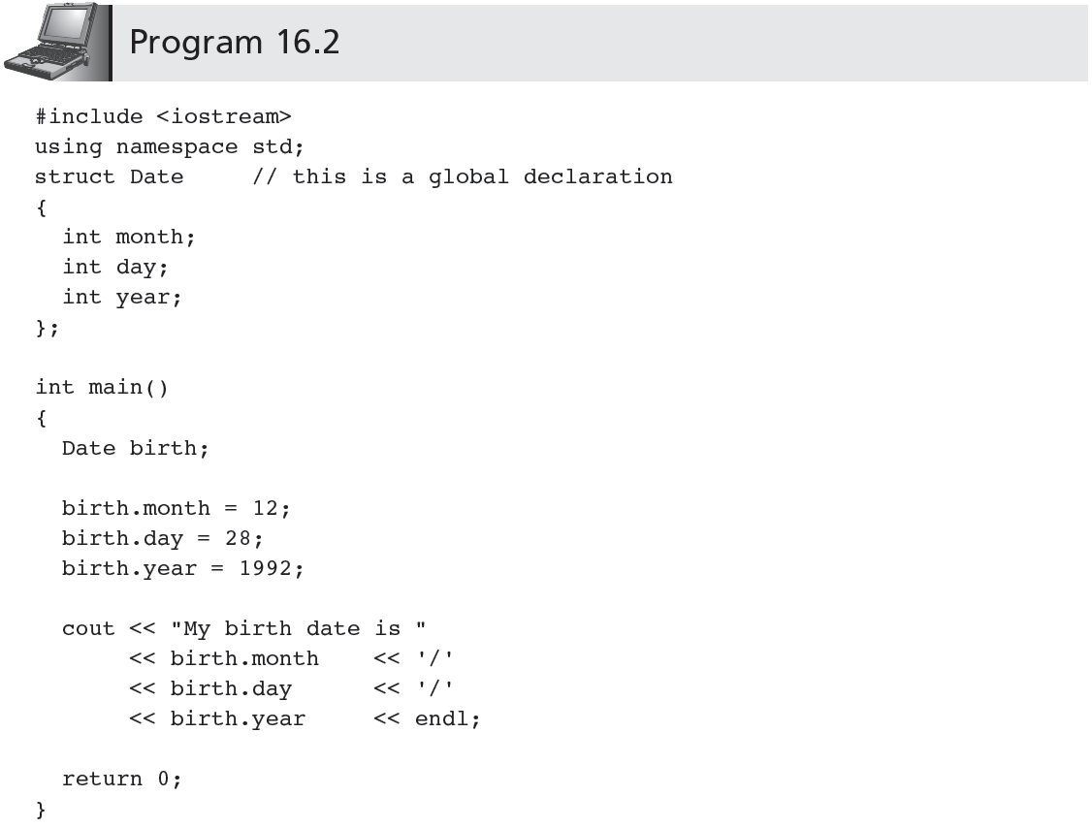
CSC 1100 – Week11
DCS, KICT
//declare the variable birth of type Date (global structure only)
A First Book of C++ 4th Edition

Slide 10
Single Structures (cont'd.)
CSC 1100 – Week11
DCS, KICT
Initialization of structures: follows same rules as initialization of arrays
Global and local structures are initialized by following the definition with list of initializers
Example: Date birth = {12, 28, 1992} can replace first four statements in main() in Program 16.2
Individual members of structure are not limited to one data type
Can be any valid C++ data type, including both arrays and structures
A First Book of C++ 4th Edition

Slide 11
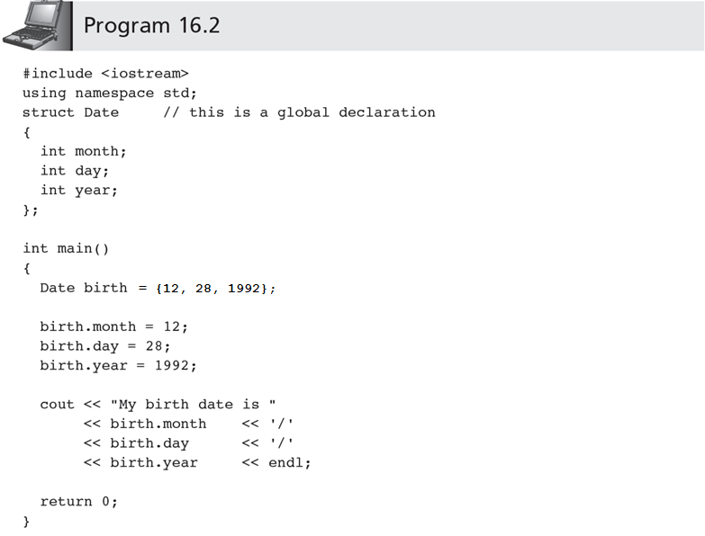
CSC 1100 – Week11
DCS, KICT
//initialize 3 birth values at declaration
//can be removed
A First Book of C++ 4th Edition

Slide 12
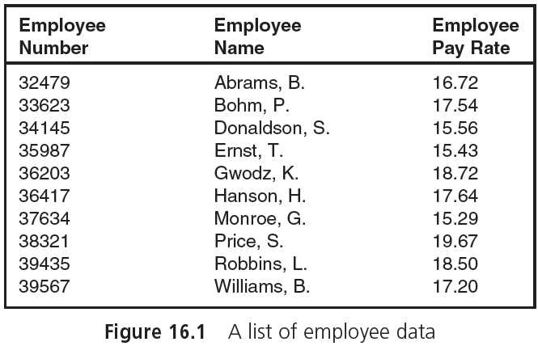
Arrays vs Structures
CSC 1100 – Week11
DCS, KICT
A First Book of C++ 4th Edition

Slide 13
Arrays of Structures
CSC 1100 – Week11
DCS, KICT
Real power of structures is realized when same structure is used for lists of data
Example: Process employee data in Figure 16.1
Option 1: Consider each column in Figure 16.1 as a separate list, stored in its own array
Employee numbers are stored in array of integers
Names are stored in array of strings/characters
Pay rate is stored in array of double-precision numbers
Correspondence between items for individual employee is maintained by storing employee’s data in same array position in each array
int empNum[10];
string empName[10];
double payRate[10];
3 different arrays for Employee information
A First Book of C++ 4th Edition

Slide 14
Arrays of Structures (cont'd.)
CSC 1100 – Week11
DCS, KICT
Option 1: Declare 3 different arrays with 3 data types
int empNum[10] = {32479, 33623, 34145,...};
string empName[10] = {"Abrams, B.", "Bohm, P.", "Donaldson,S.", ...};
double payRate[10] = {16.72, 17.54, 15.56, ... };
Option 1 is not a good choice
Items related to single employee constitute a natural organization of data into structures
Better option: use structure shown in Figure 16.2
Data can be processed as single array of ten structures
Maintains integrity of the data organization as a record
A First Book of C++ 4th Edition

Slide 15
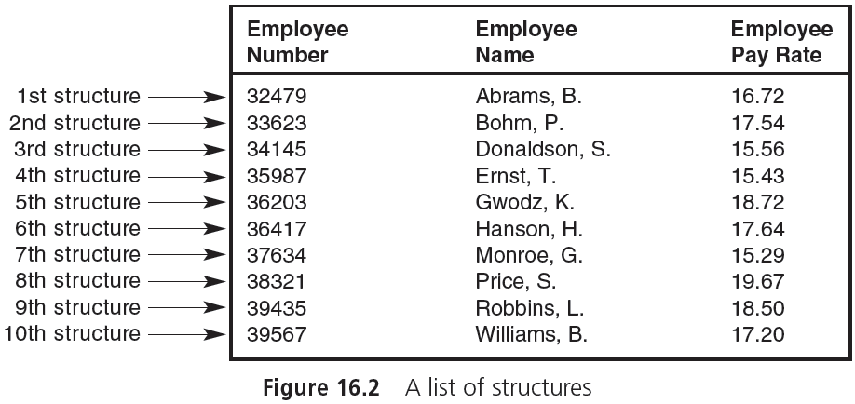
Arrays of Structures (cont'd.)
CSC 1100 – Week11
DCS, KICT
A First Book of C++ 4th Edition

Slide 16
Arrays of Structures (cont'd.)
CSC 1100 – Week11
DCS, KICT
Declaring an array of structures: same as declaring an array of any other variable type
If data type PayRecord is declared as (global):
struct PayRecord
{
int idNum;
string name;
double rate;
};
An array of ten such structures can be defined as:
PayRecord employee[10];//array & size
A First Book of C++ 4th Edition

Slide 17
Arrays of Structures (cont'd.)
CSC 1100 – Week11
DCS, KICT
Referencing an item in an array of structures:
employee[0].rate refers to rate member of the first employee structure in employee array
Including structures as elements of array makes it possible to process list of structures using standard array programming techniques
The following program displays first five employee records illustrated in Figure 16.2
A First Book of C++ 4th Edition

Slide 18
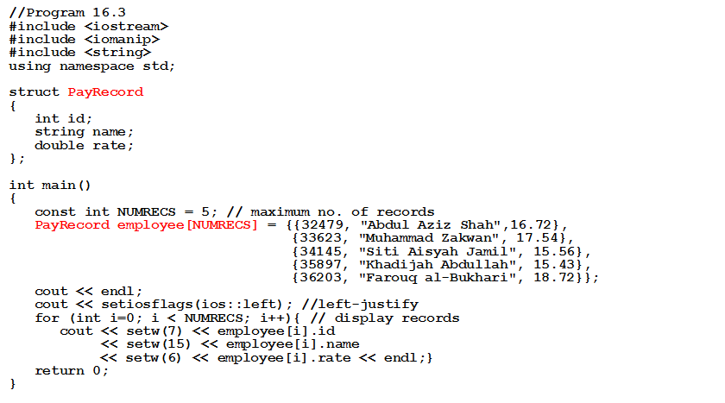
Arrays of Structures (cont'd.)
CSC 1100 – Week11
DCS, KICT
declare the structure PayRecord
one datatype per column
initialize array structure with values
declare an array of structure of size 5
A First Book of C++ 4th Edition

Slide 19
Structures as Function Arguments
CSC 1100 – Week11
DCS, KICT
Structure members can be passed to a function in the same manner as a scalar variable
Example: Given the structure definition:
struct
{
int idNum;
double payRate;
double hours;
} emp;
the statement display(emp.idNum); passes a copy of the structure member emp.idNum to a function named display()
A First Book of C++ 4th Edition

Slide 20
Structures as Function Arguments (cont'd.)
CSC 1100 – Week11
DCS, KICT
Passing complete copies of all members of structure to a function
Include name of structure as argument
Example: The function call calcNet(emp); passes a copy of the complete emp structure to function calcNet()
A declaration must be made to receive structure
A First Book of C++ 4th Edition

Slide 21
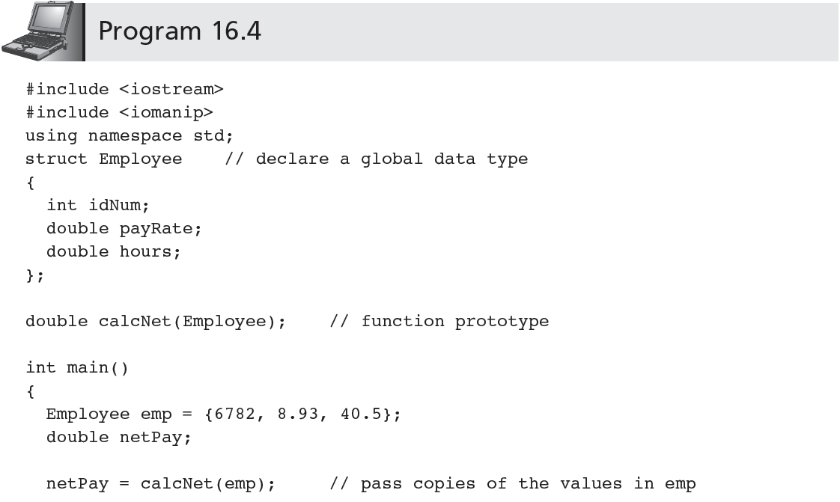
CSC 1100 – Week11
DCS, KICT
(Passing structures as arguments)
idnum
payRate
hours
return value from function calcNet()
A First Book of C++ 4th Edition

Slide 22
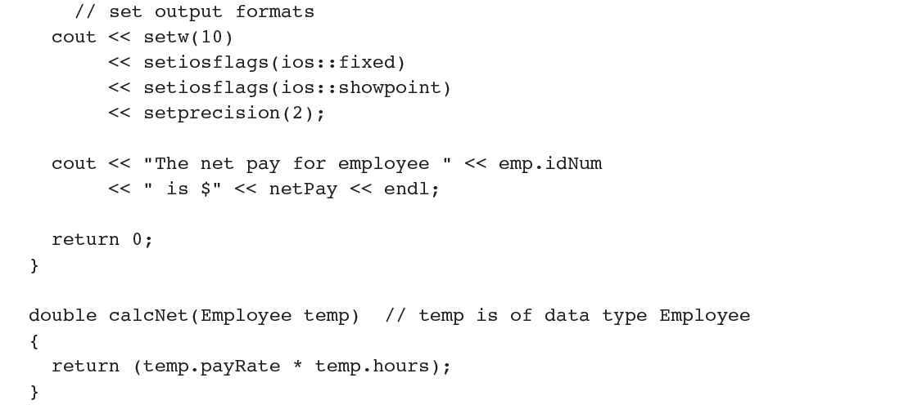
Structures as Function Arguments (cont'd.)
CSC 1100 – Week11
DCS, KICT
temp = emp // assign emp from main to temp
A First Book of C++ 4th Edition

Slide 23
Structures as Function Arguments (cont'd.)
CSC 1100 – Week11
DCS, KICT
Example: Program 16.4 declares a global data type for Employee structure
This type is then used by both main() and calcNet() functions to define specific structures with names emp and temp
Output from Program 16.4 :
The net pay for employee 6782 is $361.66
A First Book of C++ 4th Edition

Slide 24
Structures as Function Arguments (cont'd.)
CSC 1100 – Week11
DCS, KICT
In Program 16.4, both main() and calcNet() use the Employee data type
The variables defined in main() and calcNet()are different structures
Changes to local temp variable in calcNet() are not reflected in emp variable of main()
Same structure variable name could have been used in both functions with no ambiguity
Both structure variables are local to their respective functions
A First Book of C++ 4th Edition

